Slide 1


NOMINEES AND WINNERS ACADEMY AWARDS
Presenting
By
Akanksha Chaturvedi
Huzefa Shabbir Sadikot
Nagul Meera Shaik

Slide 2

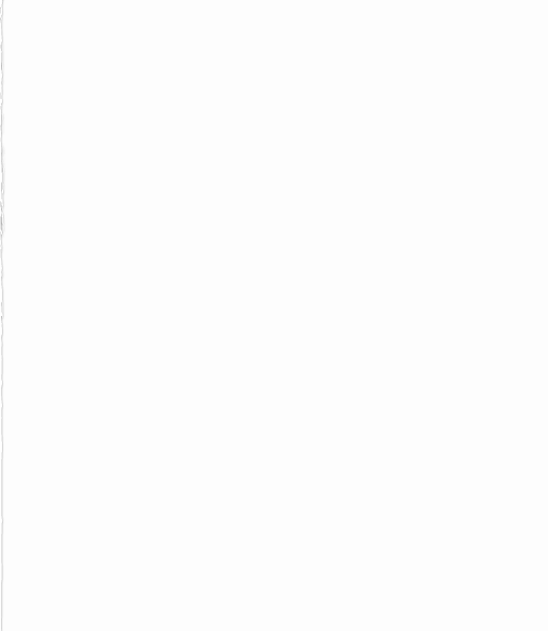
AGENDA
Problem Statement
Graph Database
Model the Database
Relationship with nodes and loops
Cleaning the data
Transform data
Perform Aggregate Operations
Conclusion

Slide 3
PROBLEM STATEMENT
This problem defines the academy awards of the actors and directors nominated for a particular role.
We have to create nodes using the graph database neo4j by showing the relationship between various nodes.

Slide 4
EXPLAIN HOW GRAPH DATABASE IS BEST FIT FOR OUR PROBLEM
A graph database is a type of database that stores data in a graph structure, with nodes representing entities and edges representing the relationships between them.
This type of database is particularly well-suited for problems that involve complex relationships between entities, such as the nominees and winners of the Academy Awards.
Graph databases also allow for flexible querying and analysis of the data, as they allow for complex queries involving multiple levels of relationships.
Overall, a graph database would be a good fit for managing and analyzing the complex relationships between the nominees and winners of the Academy Awards.

Slide 5
MODEL THE GRAPH DATABASE
Modelling the graph database involves various steps like identifying the entities and relationships in your model, defining the node labels and edges, defining the relationship types, adding properties to nodes and relationships, creating the graphs, and querying the graph.
First, we created the database, created the labels for nodes and defined the relationships between the nodes.

Slide 6
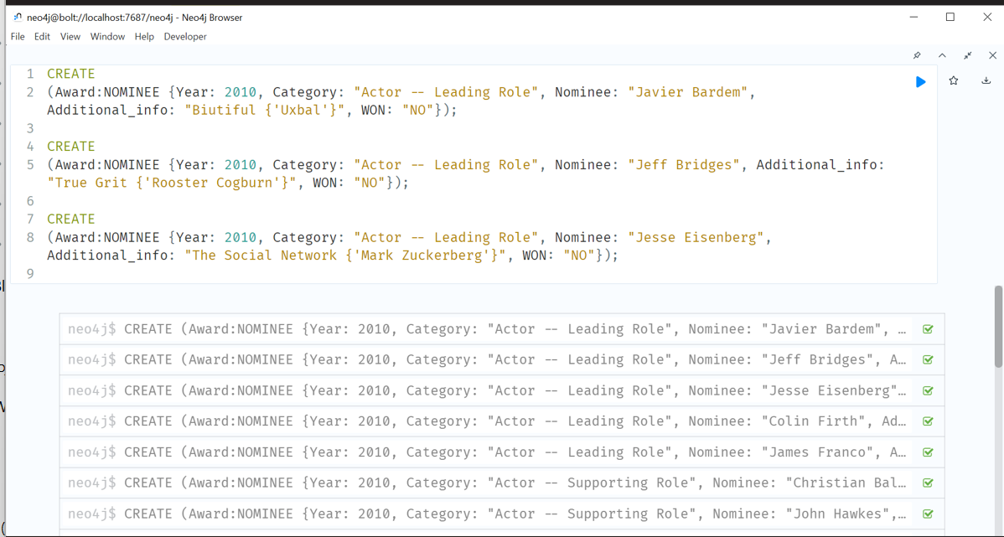

Slide 7
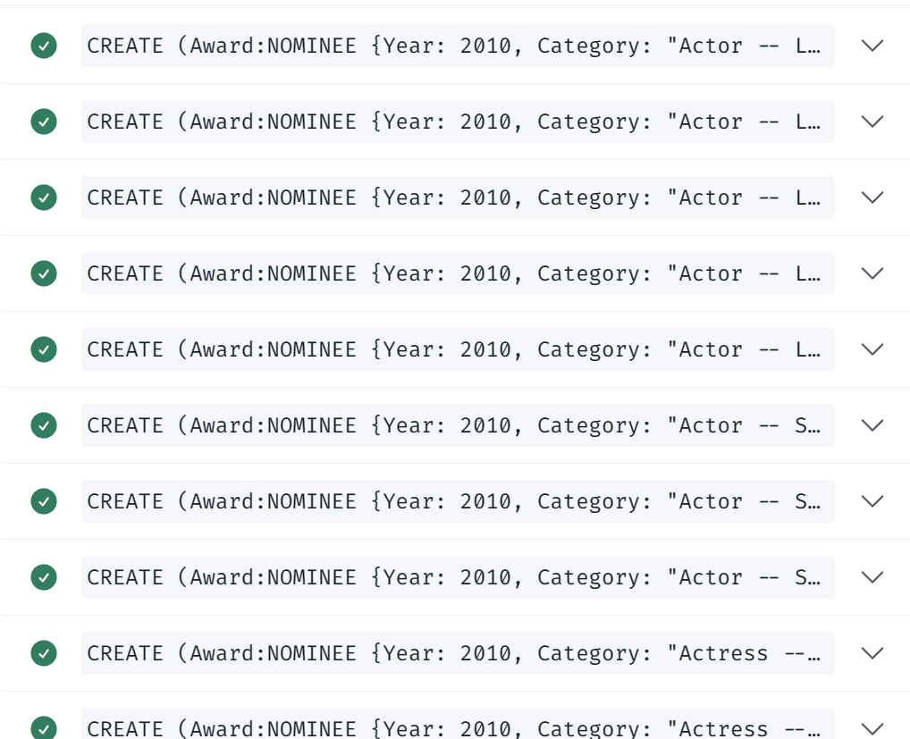

Slide 8
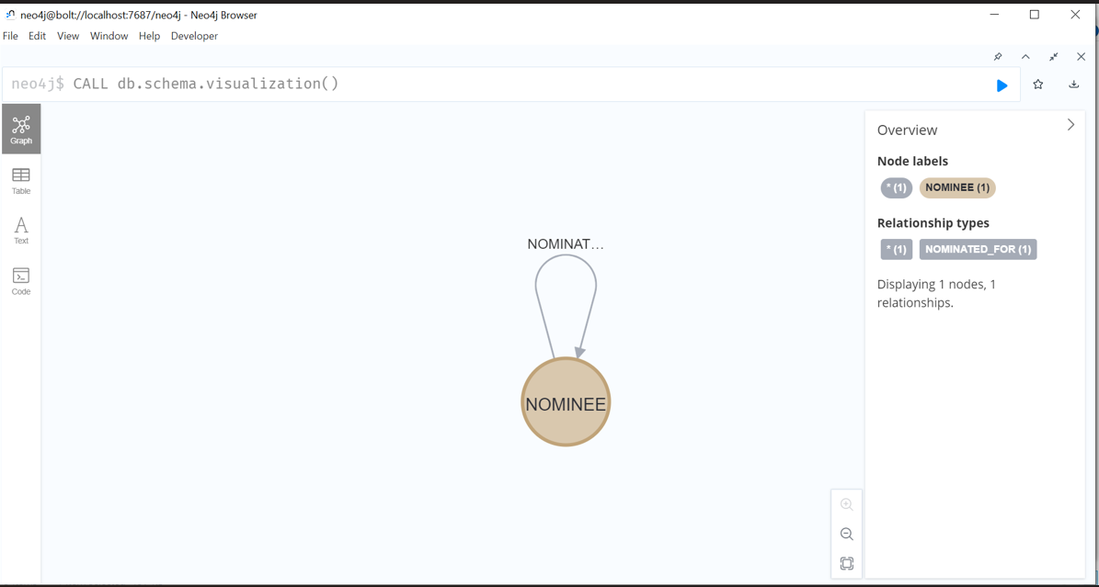
Database schema

Slide 9
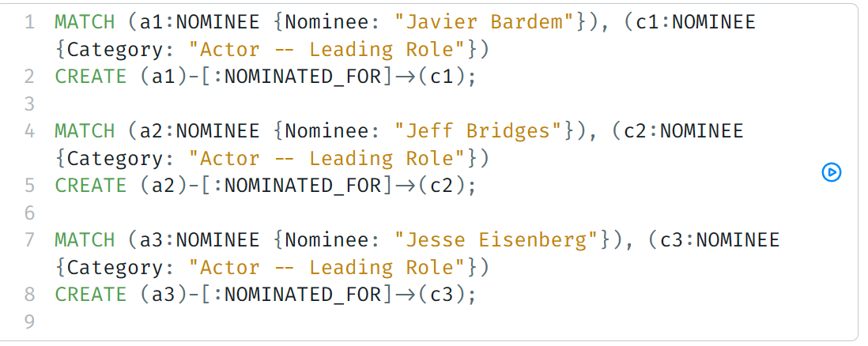
After creating the nodes, we need to create the relationships between the nodes who were nominated for actors and the awards. These relationships are created by using commands.

Slide 10
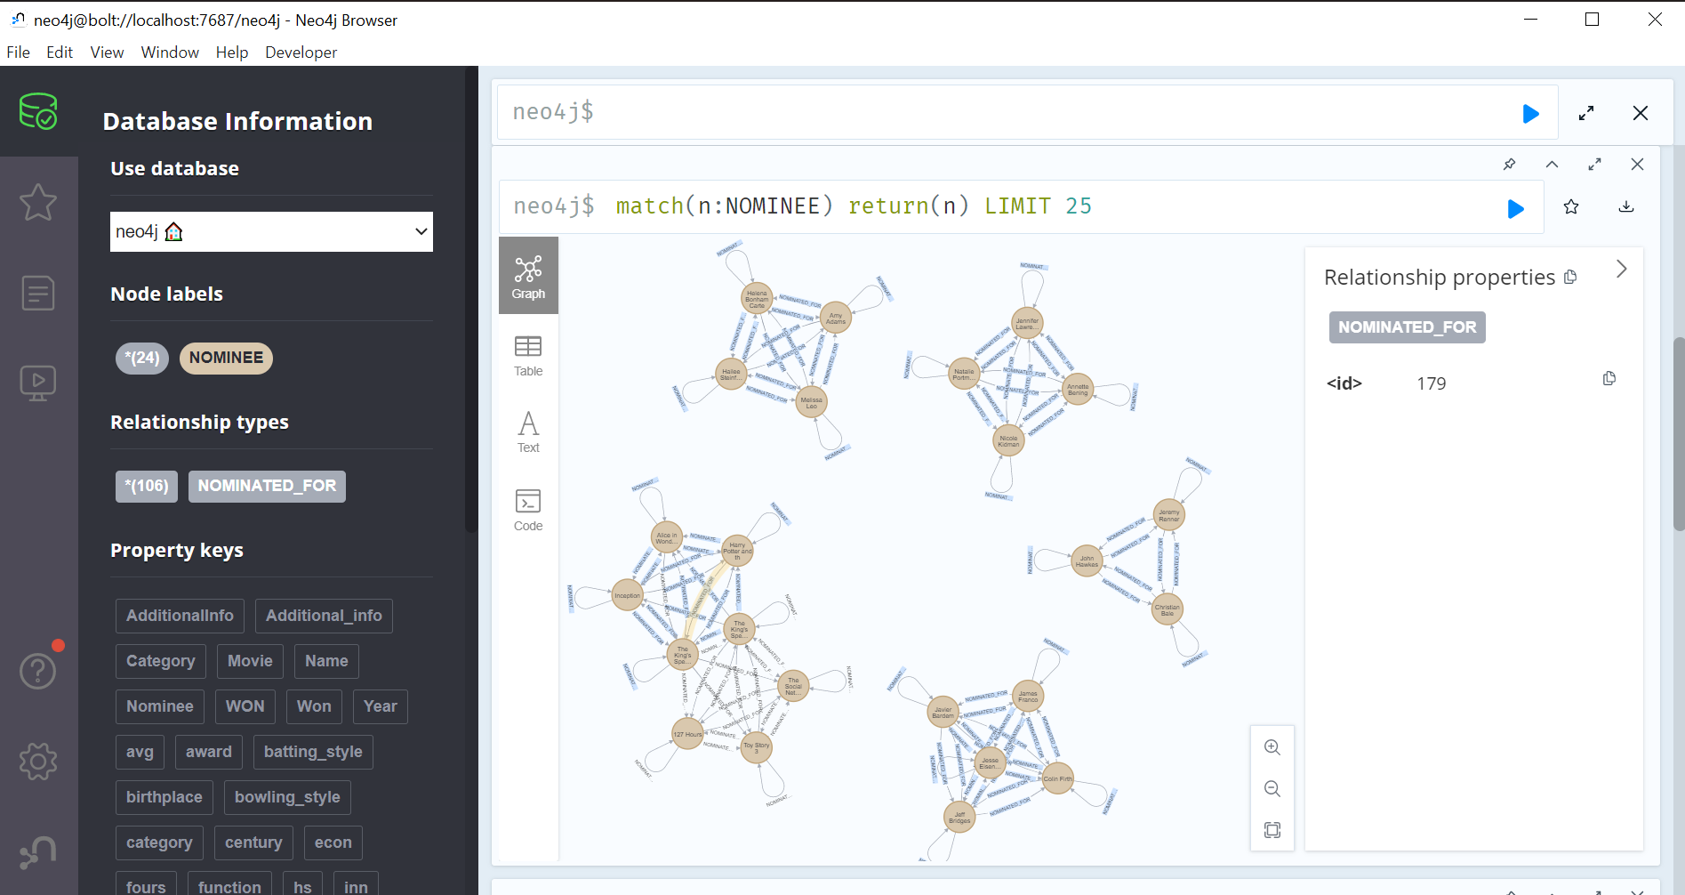

Slide 11
MODEL WITH LOOPS
To check the property of nodes:
Syntax: MATCH (n)
WHERE (n)-[:RELATIONSHIP*]->(n)
RETURN n
n is a placeholder for any node in your graph.
The [: RELATIONSHIP*] syntax specifies that we want to match any path that includes zero or more relationships.
The -> and <- arrows indicate the direction of the relationship.
The WHERE clause filters the results to only include nodes that have a relationship that forms a cycle with itself.
Finally, the RETURN clause returns all nodes that match the query.

Slide 12
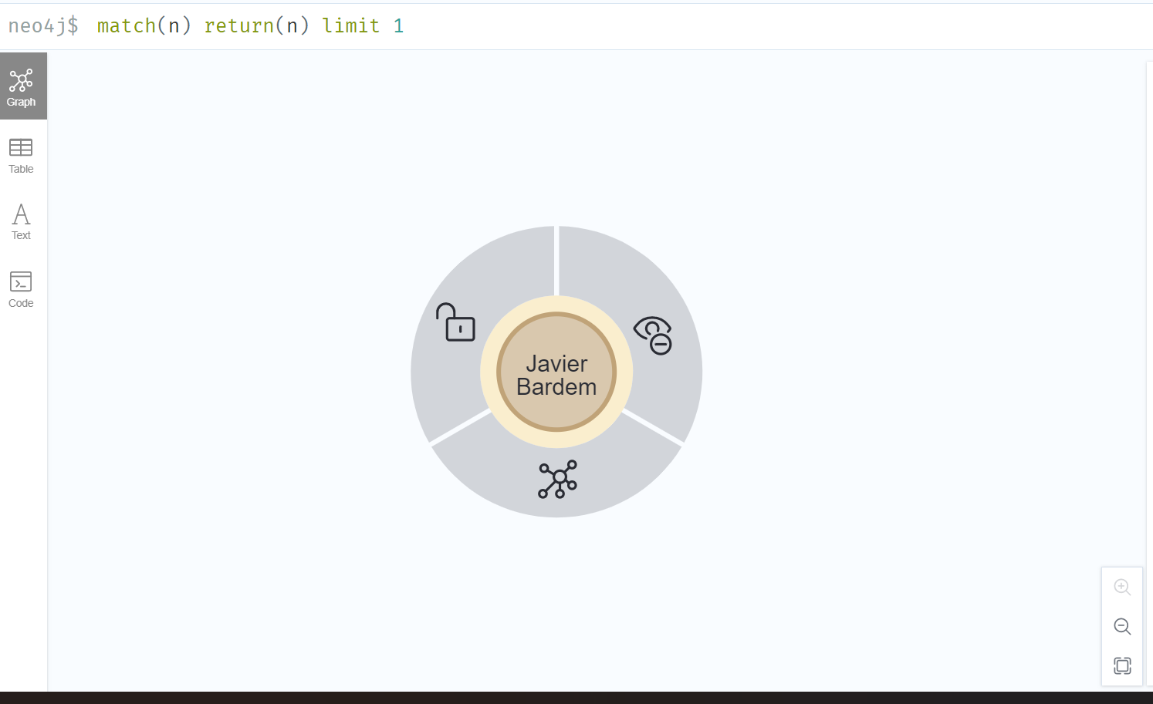
PROPERTY OF THE NODE

Slide 13
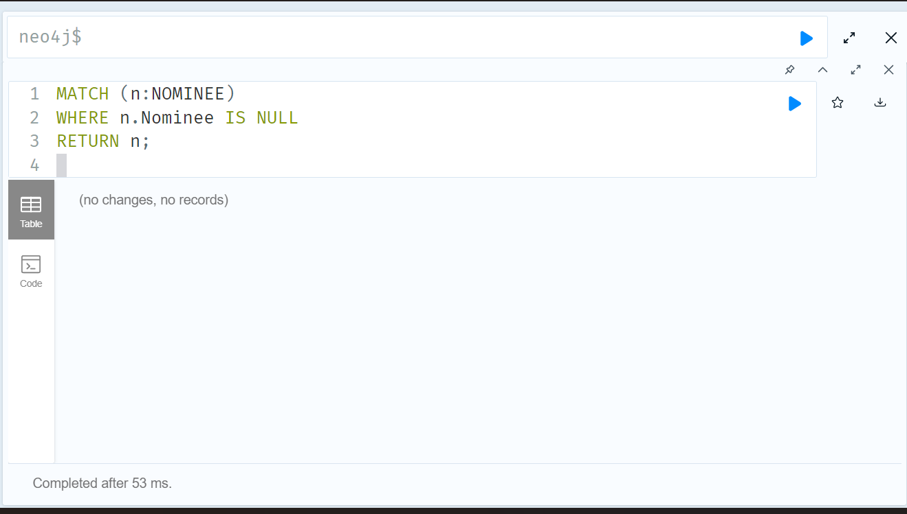
CLEANING THE DATA FOR ANY NULL VALUES
There are no null values present in our database.

Slide 14
TRANSFORMING THE DATA
To transform data in a Neo4j graph database, you can use the Cypher query language to create new nodes, relationships, and properties based on existing data
We can create new nodes in the graph by selecting data from existing nodes and relationships and creating new nodes with the CREATE clause.
To update properties on existing nodes using the SET clause.
We can delete the nodes and relationships from the graph by using the DELETE clause

Slide 16
PERFORMING AGGREGATION OPERATIONS
To perform aggregate operations in Neo4j, we can use the Cypher query language to group nodes by common properties.
For Calculating the aggregate values, we can perform aggregate operations like counts, sums, averages, and more.

Slide 17
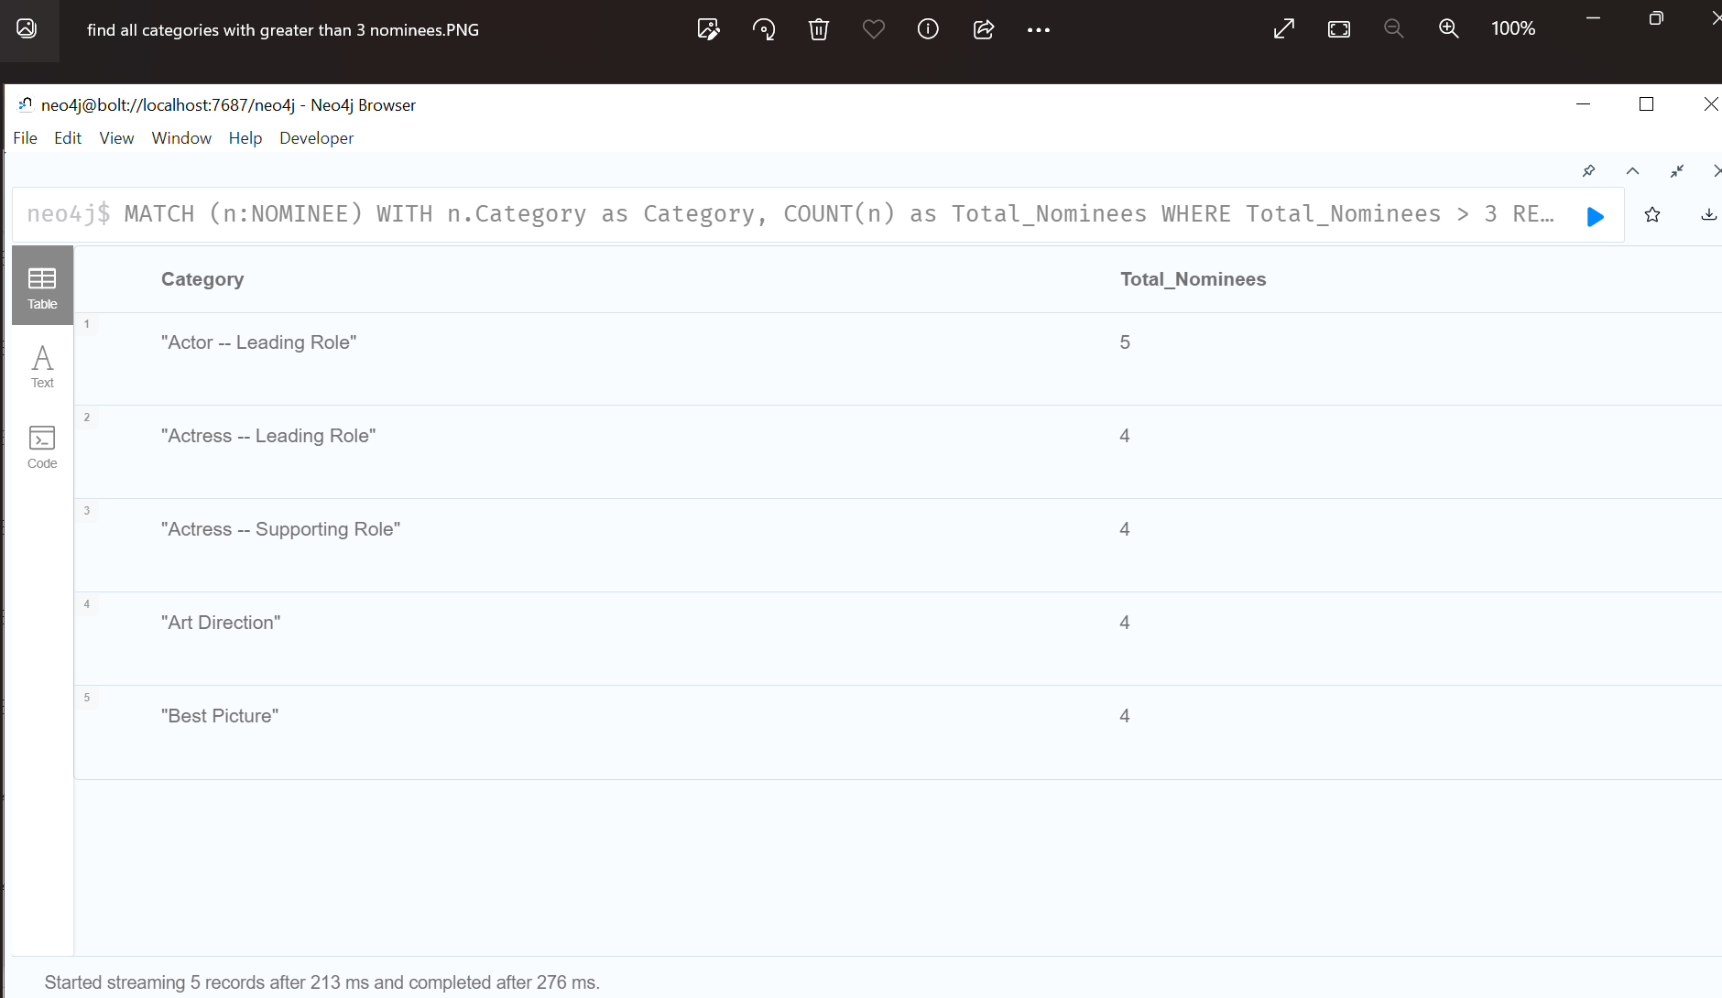
Below we can see the counts of all the nodes and relationships that are created by all the actors more than 3 times nominated. Here we have used COUNT() function to count the number of nodes to match a certain pattern.

Slide 18
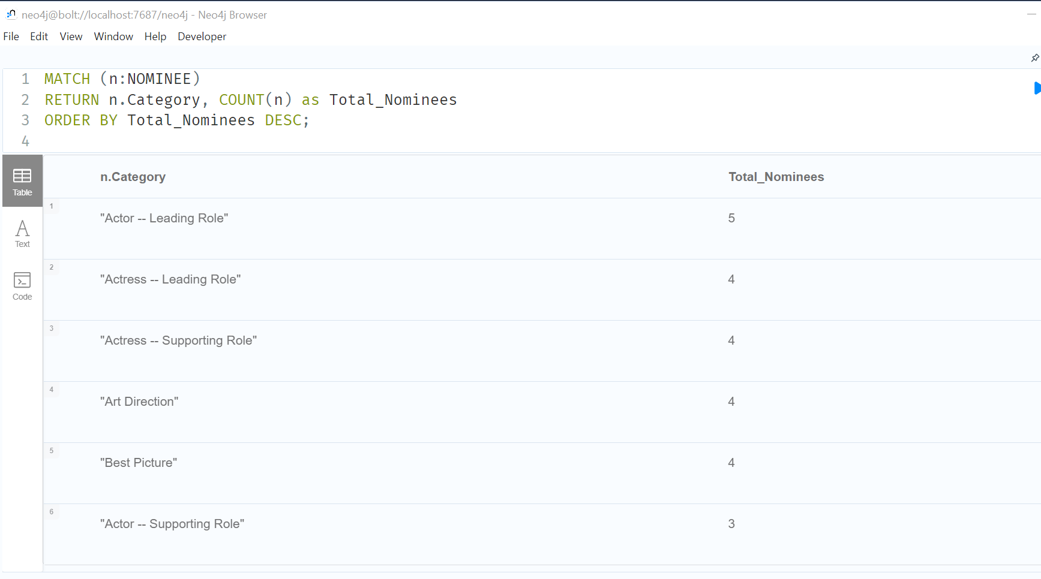
Here, we have used ORDER BY() clause to total number of nominees in each category

Slide 19
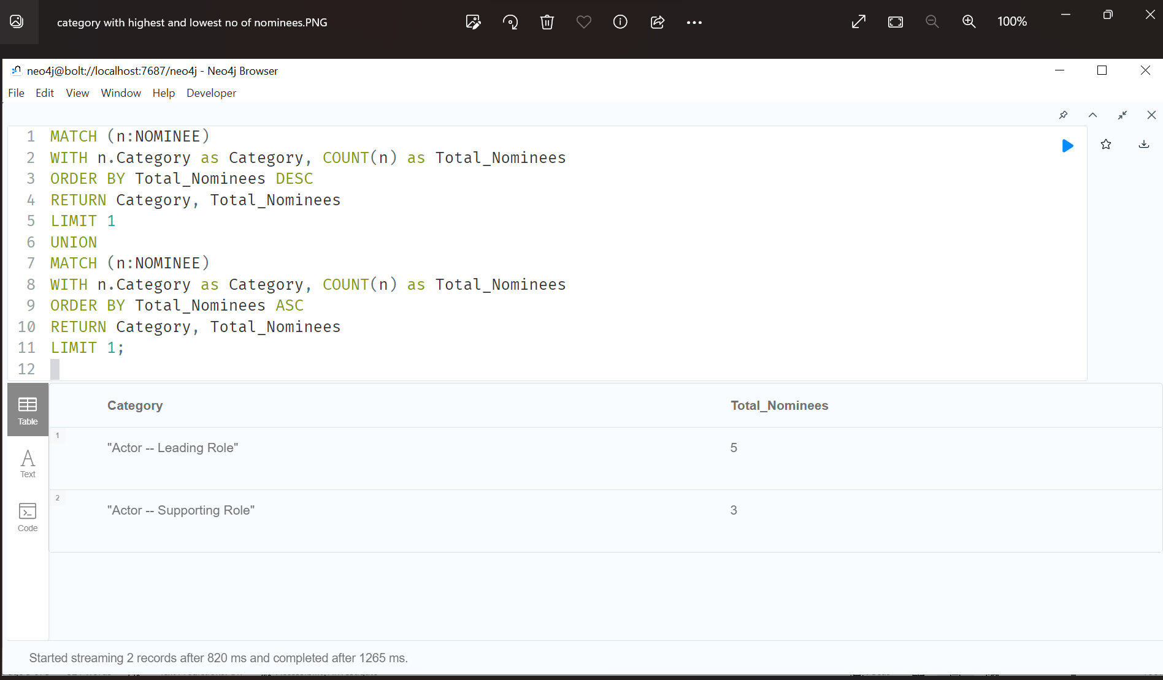
Here, we are able to see the number of the highest and lowest number of nominees. By using, UNION () clause we can calculate the sum and average of the property across a group of functions.

Slide 20
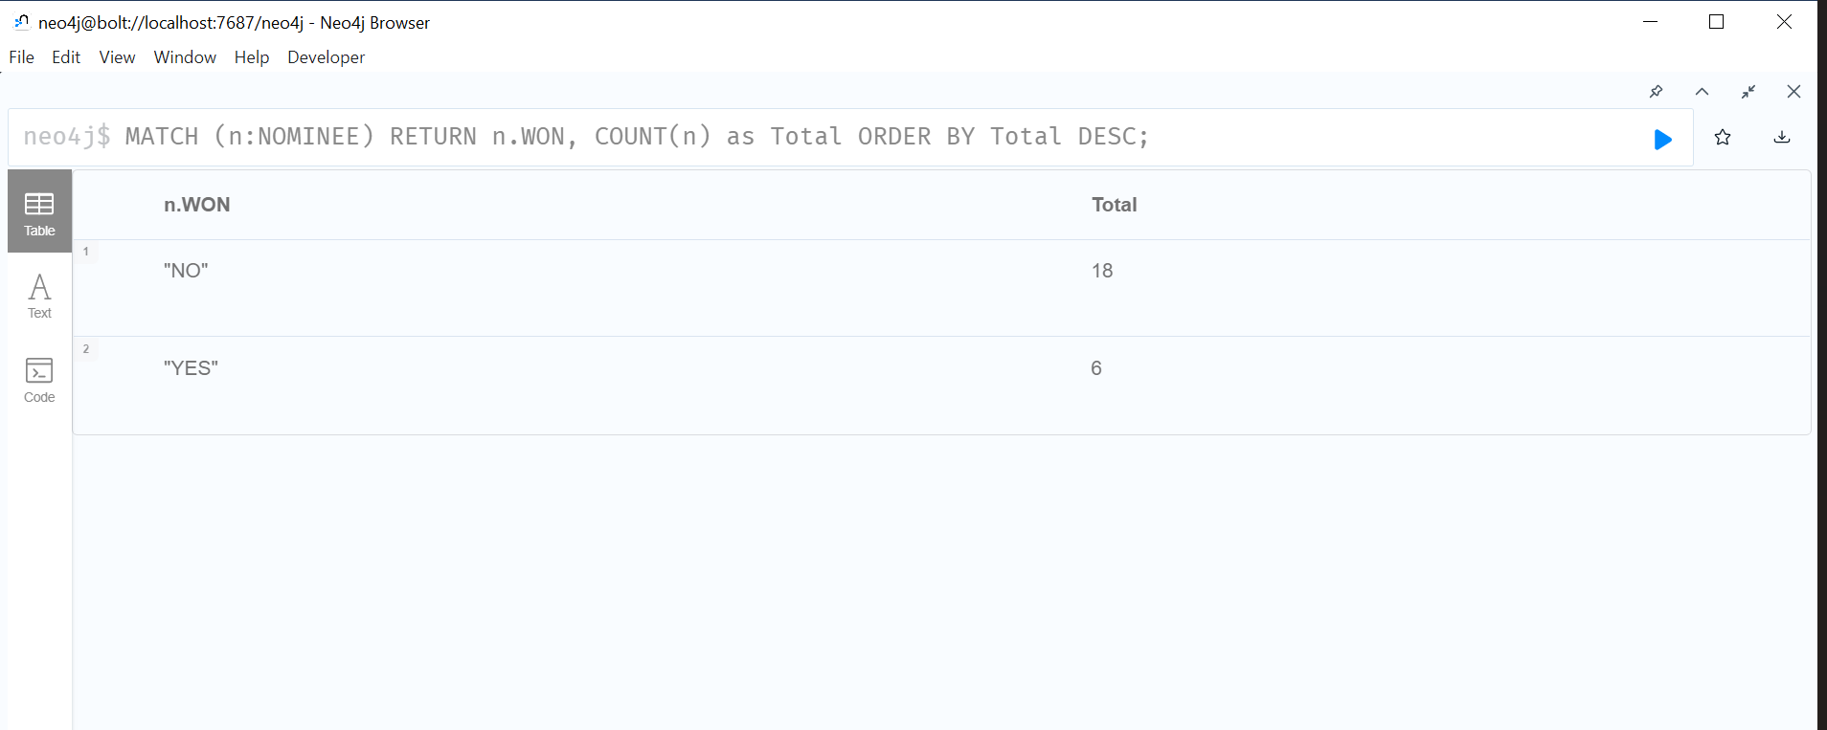
OUTPUT
Below, we can see the output of the total number of people who won the awards is 6 and the number of people who lost it is 18.

Slide 21
Conclusion
In conclusion, we were able to identify the different movies and roles that actors were nominated for, as well as the different awards that they received.
The project has also allowed us to gain insights into the patterns and trends in the data, which can be useful in various applications such as the film industry, marketing, and research.
Overall, a graph database would be a good fit for managing and analyzing the complex relationships between the actors and movies of the Academy Awards.

Slide 22


